Slide 1

Calculator in Python
By: Yazeed AlKhalaf - S190280

Slide 2
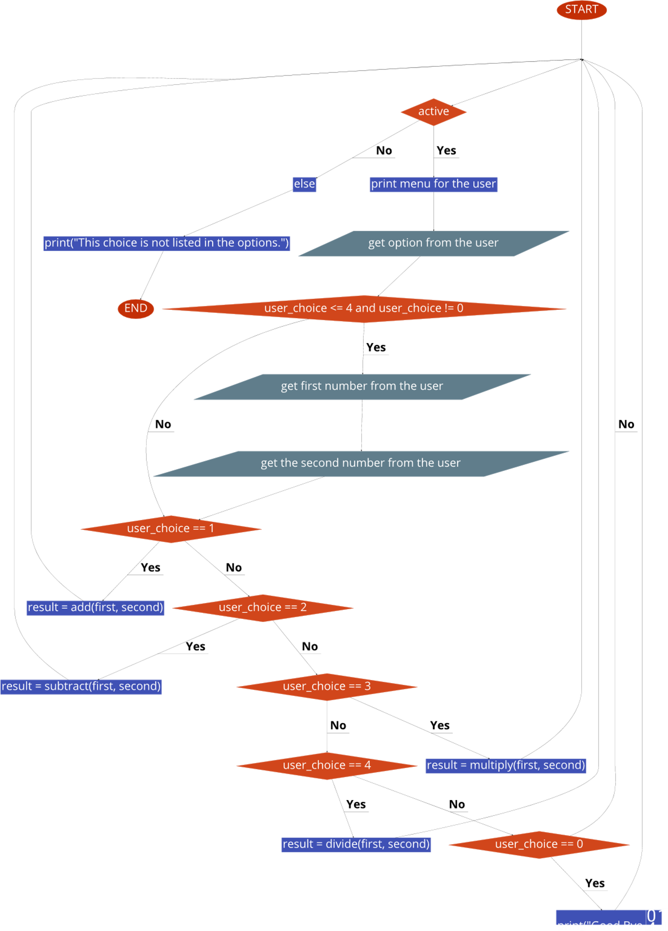
Algorithm and Flowchart
File on GitHub:
https://github.com/YazeedAlKhalaf/grade_12_ict_projects/blob/main/quarter_one_project/assets/calculator_flowchart.pdf

Slide 3
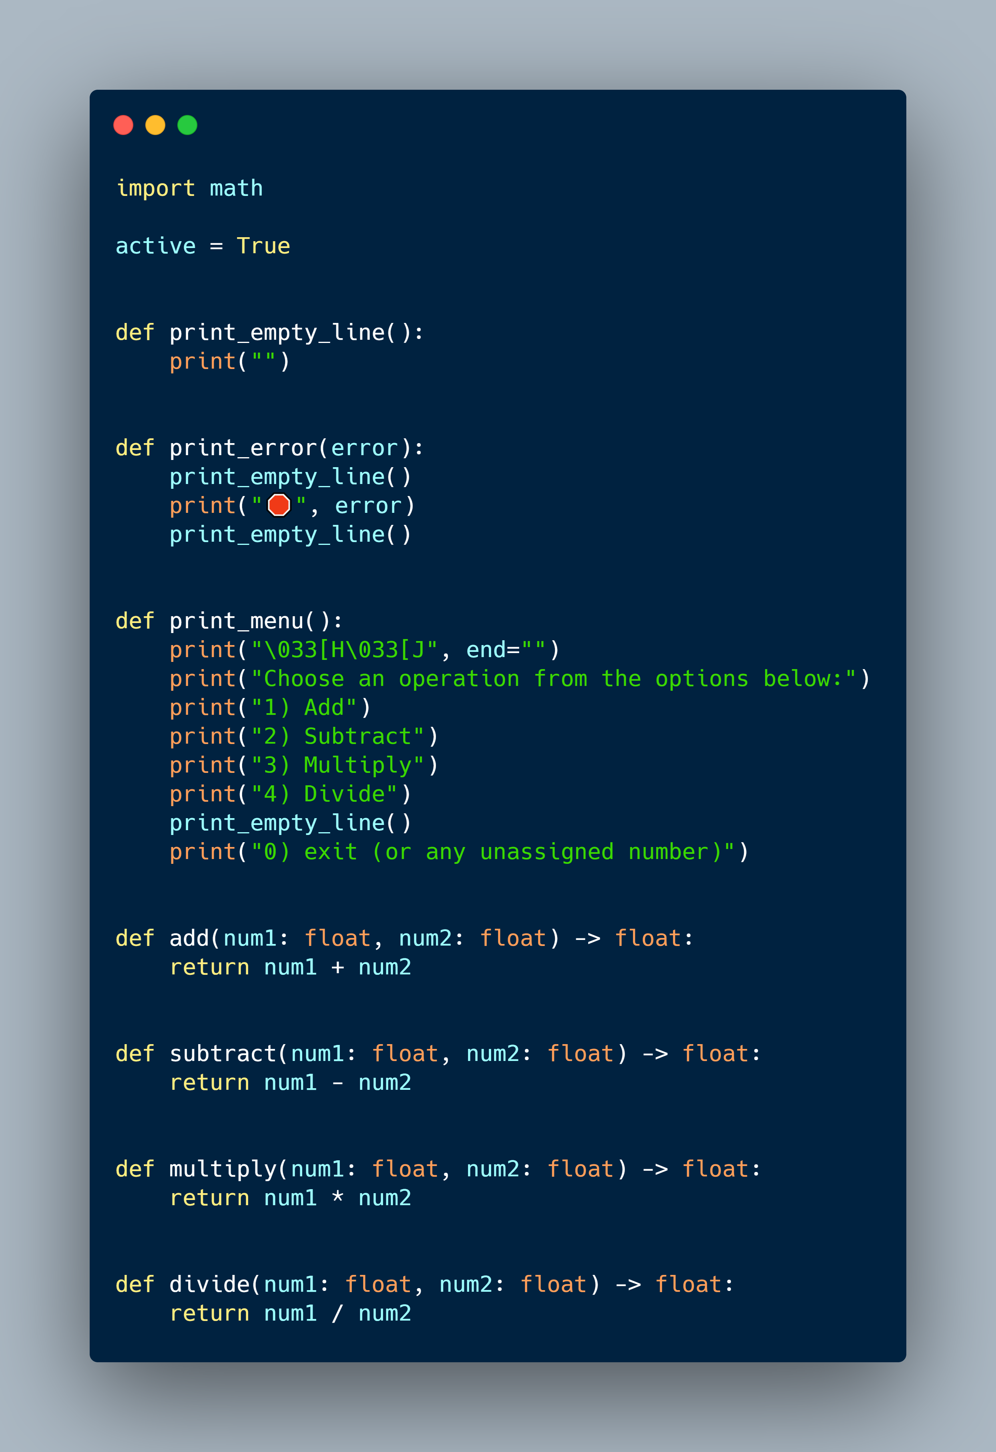
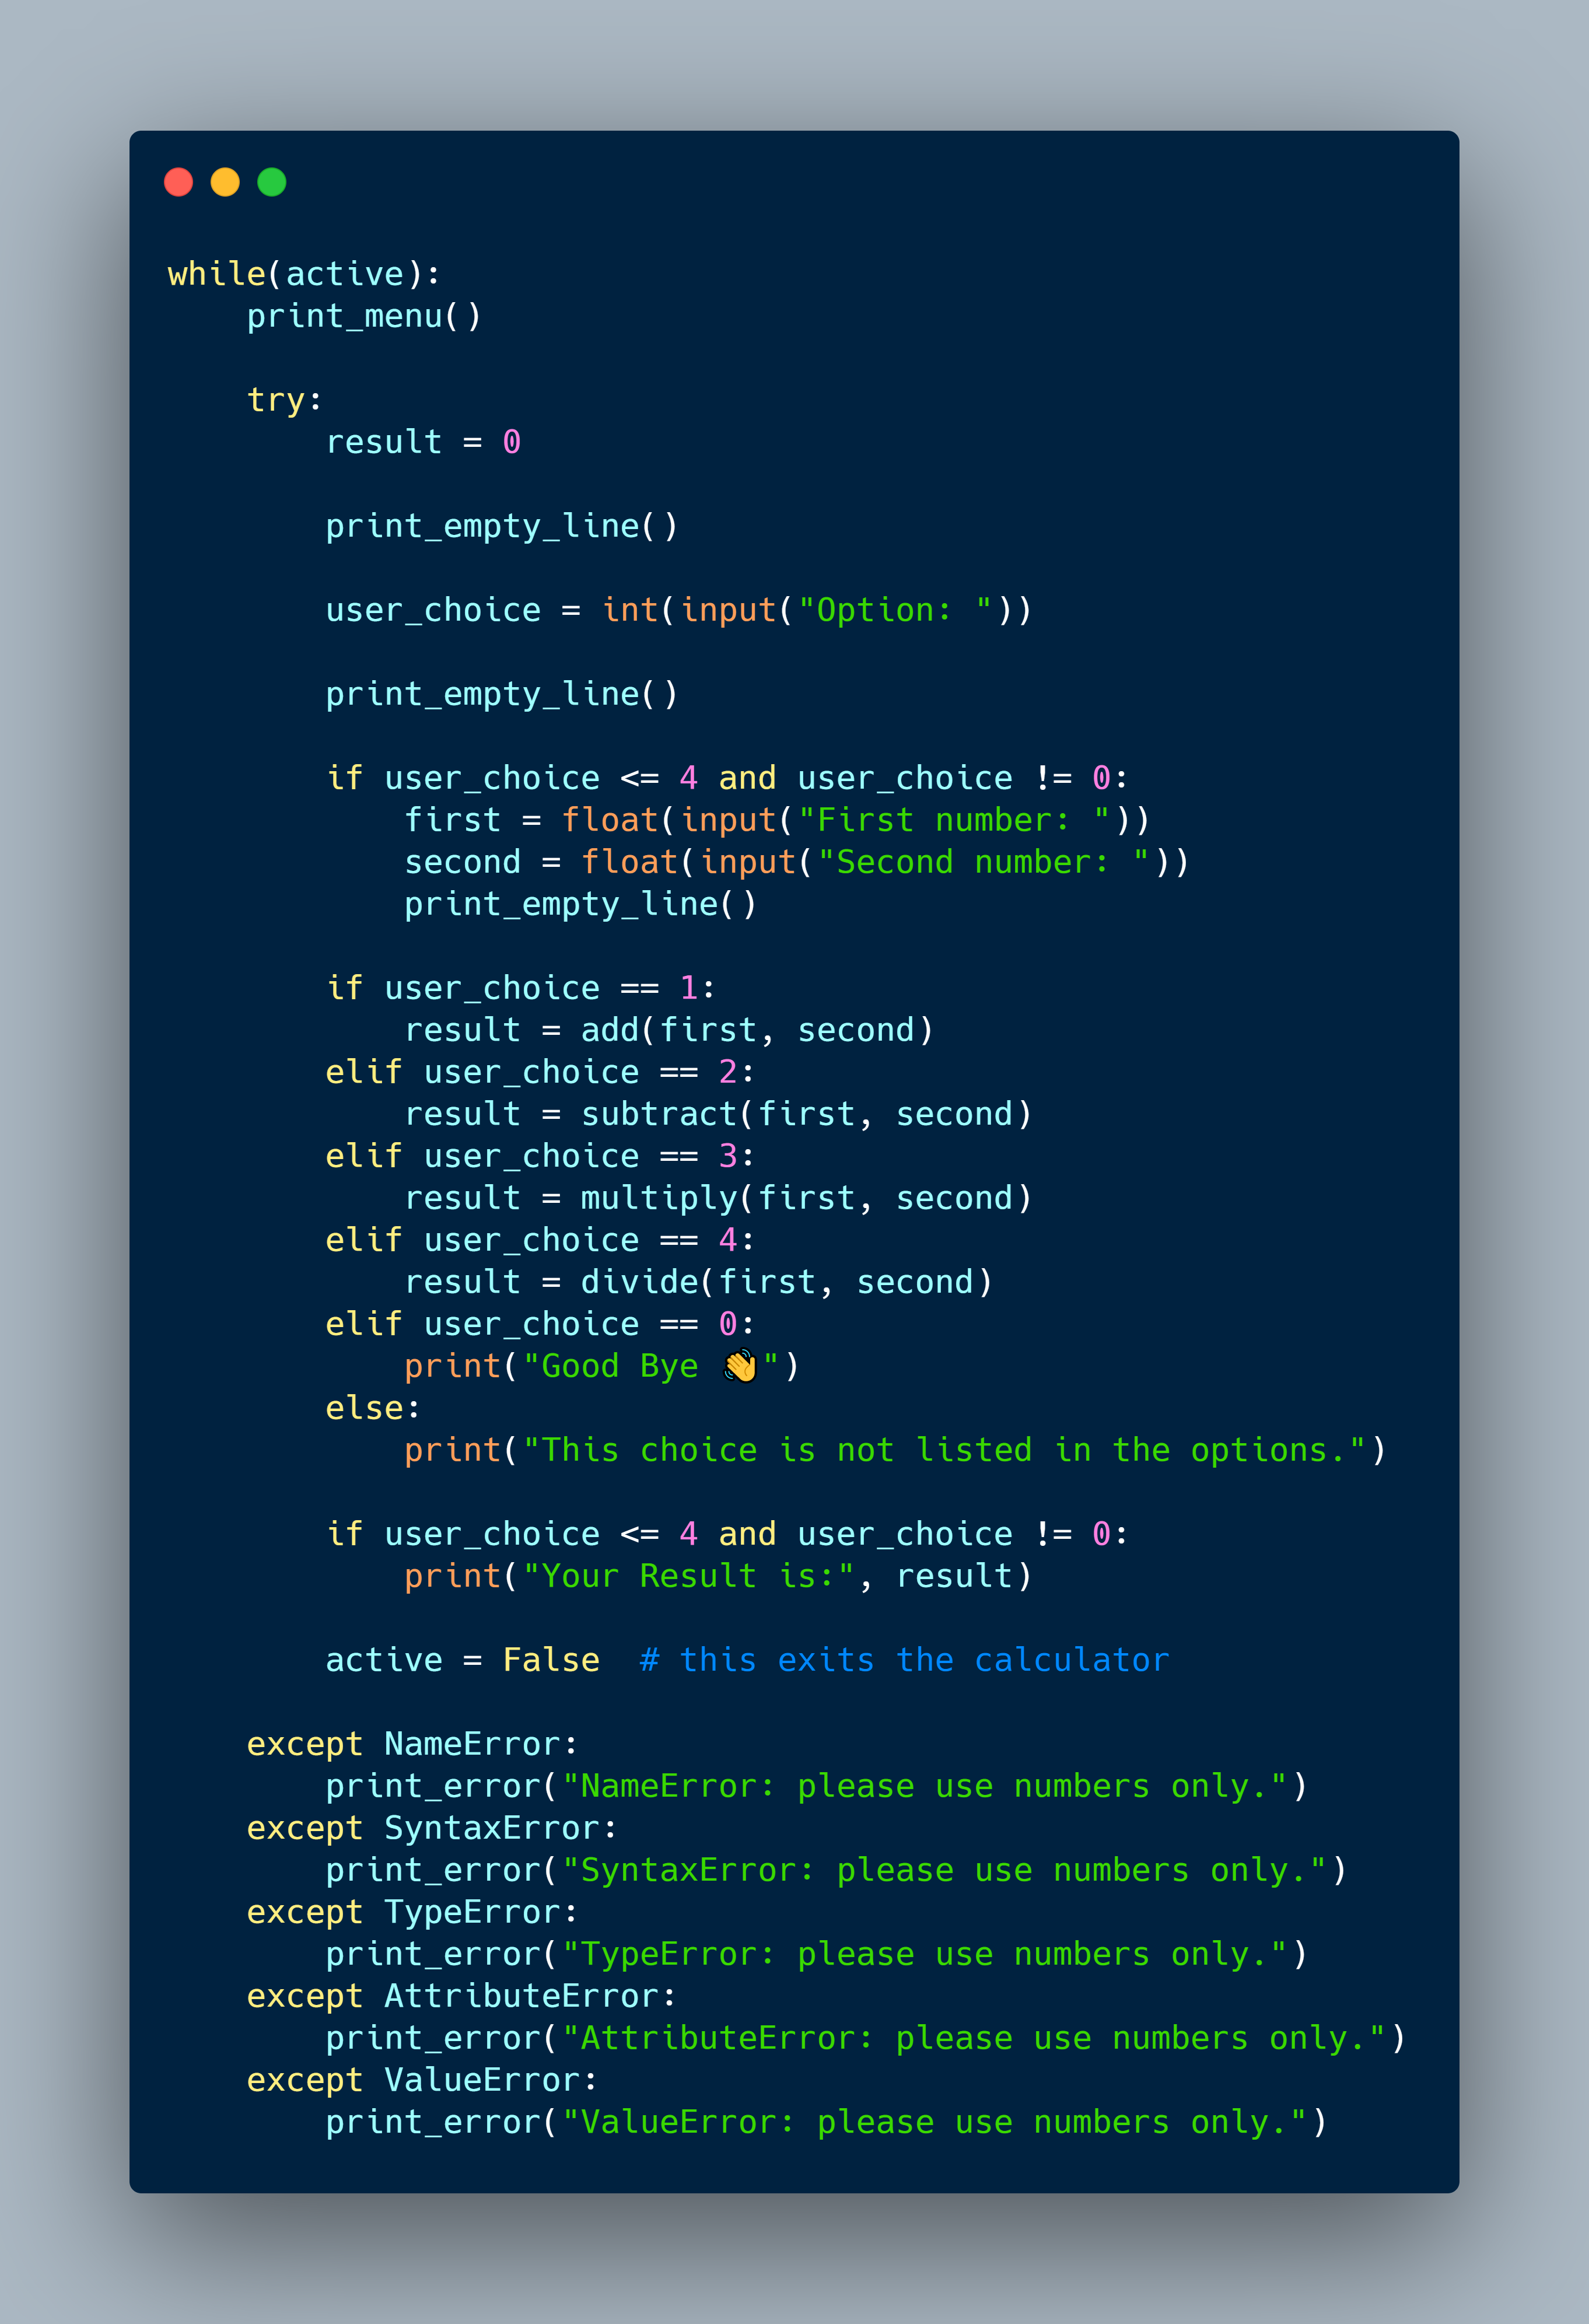
Python Program
Code on GitHub:
https://github.com/YazeedAlKhalaf/grade_12_ict_projects/tree/main/quarter_one_project

Slide 4
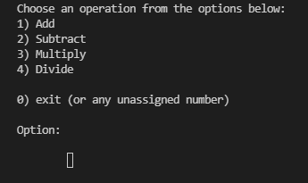
Test

Slide 5
Conclusion
I had so much fun creating this calculator. I learned so much in the Python language.
I will improve it by adding square root and squaring a number in the future.

Slide 6
Thanks
Any Questions?

